Slide 1
Update on the construction of ACTRIS-ERIC and the joint ACTRIS-EMEP European strategies
Paolo Laj
ACTRIS Scientific Chair

Slide 2
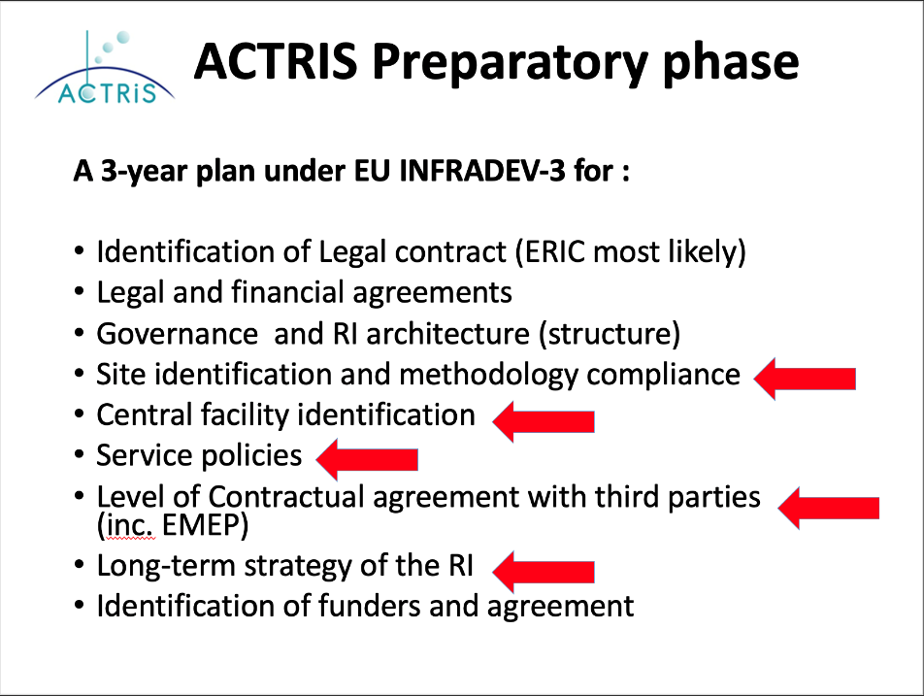
ACTRIS at TFMM 5 years ago
TFMM, May 2016
Notes:
We do not have another organigram, as all units are doing the same, but for very different types of data. I propose to choose another figure, showing DC structure and rather explain this? See next slide. I do have several more simplified versions, so I included mor ethan one, you can choose.

Slide 3
ACTRIS at TFMM 5 years ago
Predictions of 5 years ago were not too bad
Target timeline
2025 Operational Phase
2021 ACTRIS ERIC
2020 -2024 Implementation Phase
2017 -2019 Preparatory phase
2016 ACTRIS in ESFRI Roadmap
TFMM, May 2016
Notes:
We do not have another organigram, as all units are doing the same, but for very different types of data. I propose to choose another figure, showing DC structure and rather explain this? See next slide. I do have several more simplified versions, so I included mor ethan one, you can choose.

Slide 4
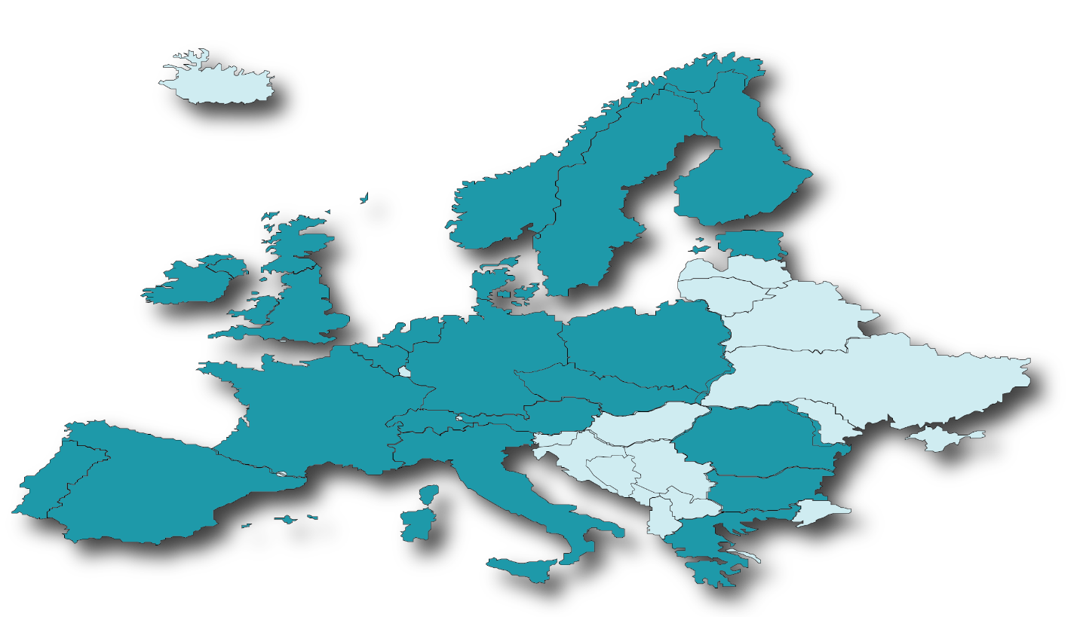
Current status of ACTRIS
In March 2021 ACTRIS Interim Council* approved unanimously the five-year financial plan, membership contributions and the Technical and Scientific Description, and gave the mandate to Finland to start the signatory process
→ A legal entity called ACTRIS ERIC will likely be established late 2021
* ACTRIS Interim Council : Finland, Italy, Romania, Poland, Greece, Switzerland, France, Germany, Austria, Bulgaria, Norway, Austria, Belgium, Cyprus, Czech Republic, Netherlands, Spain, United Kingdom, Denmark

Slide 5
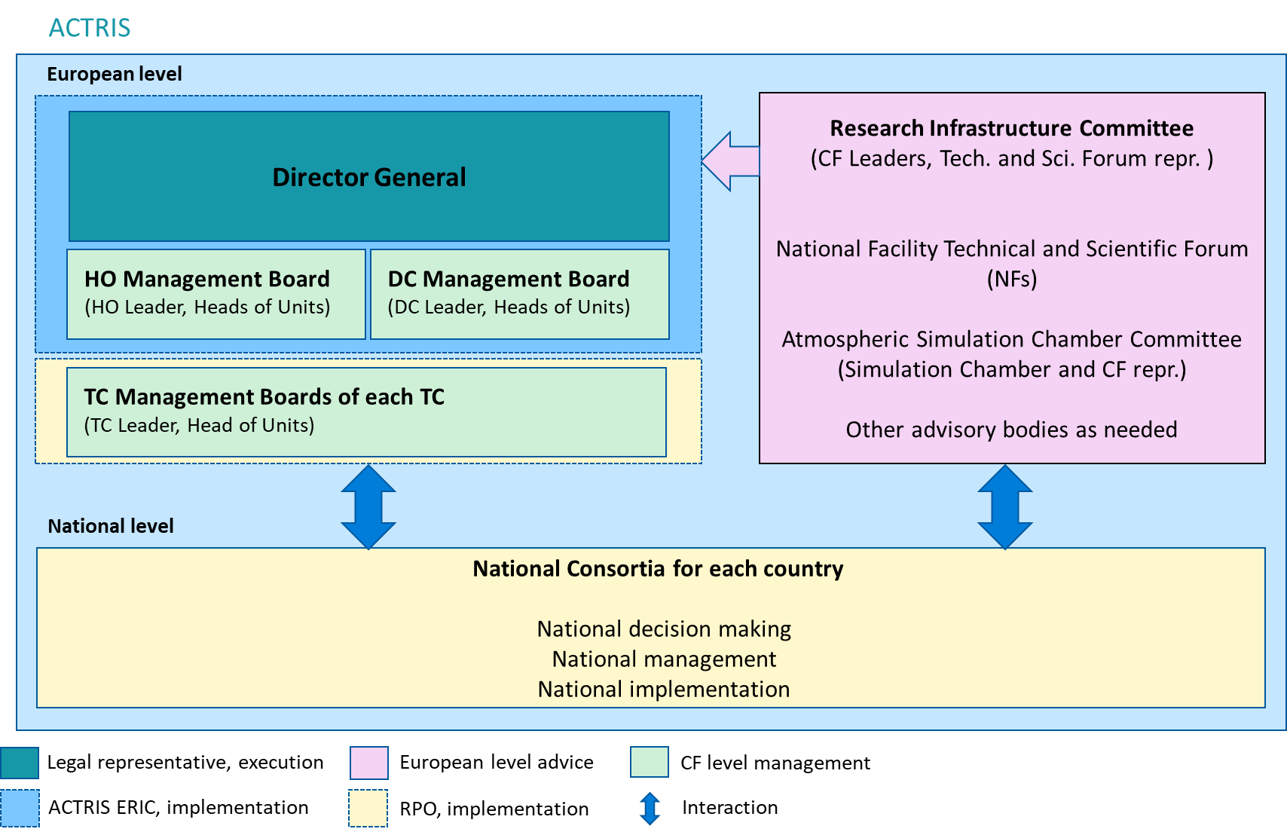
ACTRIS governance and management structure
Scientific and Innonvation Advisory board
General Assembly
Ethical Advisory board

Slide 6
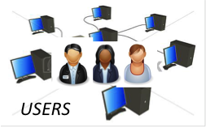
ACTRIS General Organisation
Member and Observer countries sharing
National Facilities
Topical Centres
Data Centre
Coordination Management: ACTRIS-ERIC, Head Office Helsinki
Data production and physical access
Measurement procedures and quality control
Curation and Access to data and data products
Notes:
We do not have another organigram, as all units are doing the same, but for very different types of data. I propose to choose another figure, showing DC structure and rather explain this? See next slide. I do have several more simplified versions, so I included mor ethan one, you can choose.

Slide 7
General organisation in ACTRIS data curation and delivery
Provision of data
Control of measurement procedures
Curation of data
Access to users
A national strategy to identify and maintain funding for observational and experimental Platforms
An agreement between countries for a long-term economic model to support the pan-European dimension
Governance, perimeter, financial model
Notes:
We do not have another organigram, as all units are doing the same, but for very different types of data. I propose to choose another figure, showing DC structure and rather explain this? See next slide. I do have several more simplified versions, so I included mor ethan one, you can choose.

Slide 8
The ACTRIS variables
Provision of data
Control of measurement procedures
Data Management
Access to users
ACTRIS Variables: Measurements that comply with ACTRIS recomandations throughout the production chain (NF), QA/QC (TC) to access (DC) and governance (ACTRIS ERIC)
Notes:
This is a complex slide.
ACTRIS controls the entire data value chain = What does this mean? Can’t be true…
As ACTRIS is not funding ANY measurements at all at any sites in any country; The maintenance of the instruments, funding source etc. Accordingly, in some countries EMEP link is important to fund the measurements and provide any data to ACTRIS at all. Please keep this in mind, and acknowledge this (and other funding sources like national authorities in general).
In this slide, the importance of the funding source of the actual measurements need to be added.
So « data value chain » can be changed to « production chain » and might solve this.
But rather write more like this?
ACTRIS Variables:

Slide 9
The ACTRIS Central Facilities
6 Topical Centers (TC) corresponding the ACTRIS variables
One Data Center (DC) with 6 different units
variables indicated in the EMEP monitoring strategy
ECAC | CARS | GREGARS | CIGAS | CIS | CCRES
Aerosol in-situ | Aerosol Remote Sensing | Trace gases Remote sensing | Reactive Gases in-situ | Cloud in-situ | Cloud Remote Sensing
DVAS | EBAS | ARES | CLU | GRES | ASC
Access Center | Aerosol and Trace gases in-situ | Aerosol Remote sensing | Cloud Remote-sensing | Trace Gases Remote- sensing | Simulation chambers

Slide 10
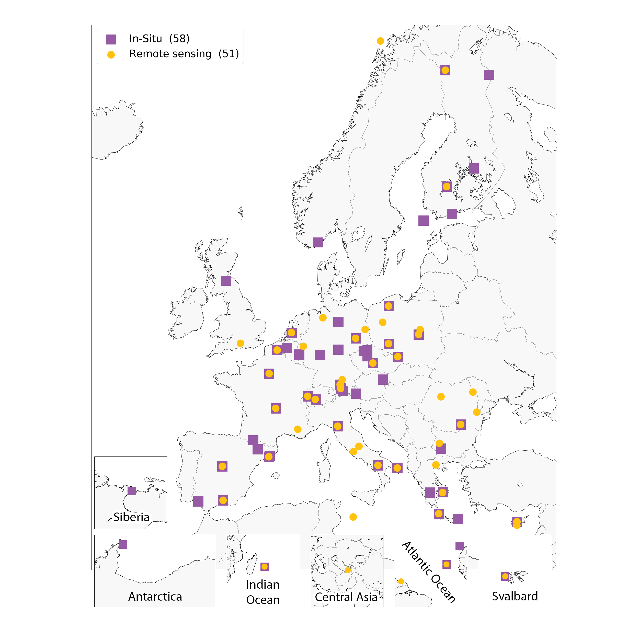
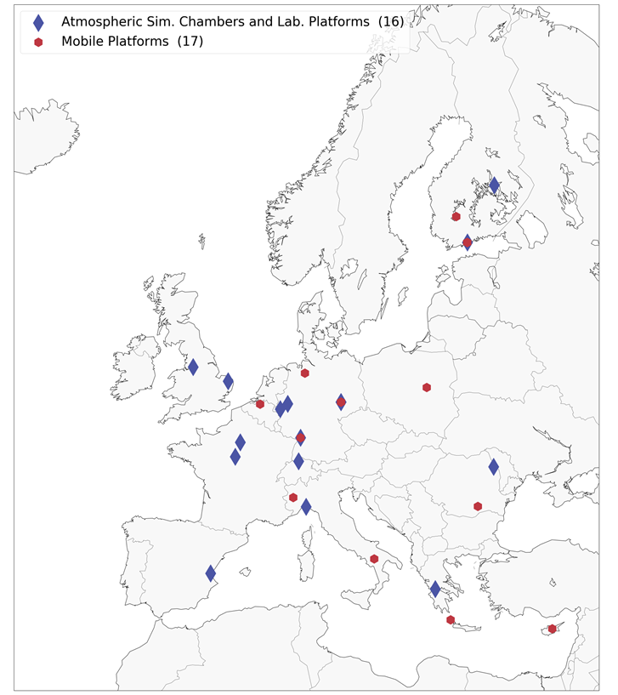
ACTRIS National Facilities
Observational Platforms
Exploratory Platforms
Some observational sites may be ACTRIS NFs, and identified as EMEP (and/or GAW) sites
Notes:
EUSAAR was based on the core sites in EMEP, and that was the start of ACTRIS in-situ. Accordingly, many sites for in-situ are shared with EMEP (the infrastructure it self) in many countries. (Yes, I know not all countries, but many).

Slide 11
ACTRIS and EMEP data value chains
Provision of data
Control of measurement procedures
Data Management
Access to users
Variable A
measured
Controlled by ACTRIS TC
Curation under ACTRIS DC/EBAS
Open access with ACTRIS (EMEP) label
Variable A
measured
Not Controled by ACTRIS TC
Curation under EMEP/EBAS
Open access with EMEP label
Variable B
measured
Not Controlled by ACTRIS TC
Curation under EMEP/EBAS
Open access with EMEP label
Notes:
Please see my note. Can you add that?

Slide 12
ACCESS to CFs for Non-ACTRIS sites
Variable A
measured
Not Controlled by ACTRIS-TC
Curation under EMEP/EBAS
Open access with EMEP label
TC services will be accessible under specific financial rules (still to be defined) for non-NFs
In the meantime, TC services can be accessed through TNA procedures under EU financing (ATMO-ACCESS 2021-2025)
Still to be discussed
→ Conditions for ACTRIS quality-stamp to be given on ACTRIS compliant observations, for non-NF sites
→ Possibility of a framework agreement between EMEP and ACTRIS (user agreement)

Slide 13
Benefits for EMEP
Benefitting from national investments for upgrading the observation platforms
Securing sustainability for central elements of the EMEP monitoring strategy
Improving QA/QC for key variables of the EMEP monitoring strategy (Metrology EMPIR projects)
Developing the FAIR dimension in ACTRIS DC
Reinforcing the international dimension
More efficient access to EU funding
Link to Copernicus CAMS and C3S and to space agencies

Slide 14
Benefits for ACTRIS
Co-funding of shared infrastructure (both national sites and DC unit) and maintenance/operation of instruments at sites in some countries
Contributing to a policy-oriented network
Improving visibility in European-scale assessments, for air quality
Closer link to the Air Quality / EEA / AQUILA framework
Reinforcing links with AQMN, EPAs and Ministries for Environment in European countries
Favouring the engagement of additional countries in ACTRIS
Notes:
I added point with funding of actual infrastructure and argument for maintenance of instruments/operation.

Slide 15
Benefits for the Users
Seamless access to data in a FAIR environment
A wider harmonisation of procedures and measurements across Europe and internationally
Improving the data access quality
Developing the added-value services (level 3)
Access to a larger number of information
Access to campaign-based data

Slide 16
Thank you !

